Slide 1

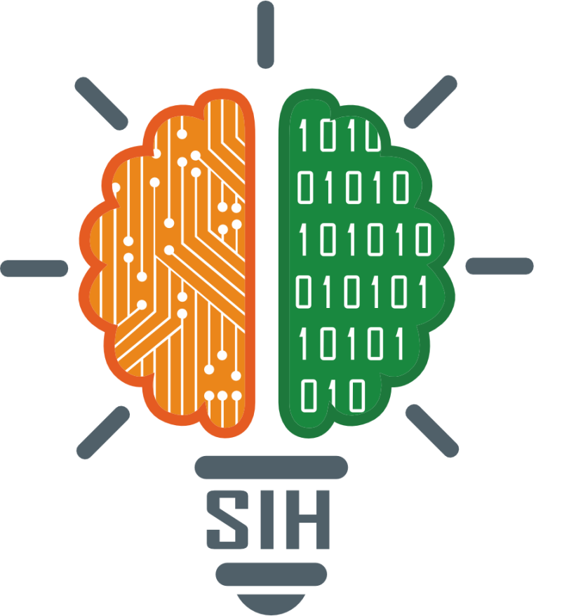
SMART INDIA HACKATHON 2025
A Multimodal RAG-based System for Unified Intelligence Discovery
Problem Statement ID – 25231
Problem Statement Title- Same as above written
Theme- Smart Automation
PS Category- Software
Team ID-
Team Name - Gnosvia

Slide 2
Synapse: A Unified Knowledge Engine
Gnosvia
Proposed Solution :-
A completely offline and secure unified platform to ingest, understand, and query diverse data formats (PDF, DOCX, images, audio), breaking down traditional information silos.
Leverages a Multimodal Retrieval-Augmented Generation (RAG) architecture to perform semantic searches across all data types from a single interface.
Users can ask questions in plain language (e.g., "Summarize the audio call that mentions the 'Project Alpha' screenshot") and receive consolidated answers.
Every generated answer is grounded in the source data, providing transparent, clickable citations to the original document, image, or audio segment for complete verifiability.

Slide 3
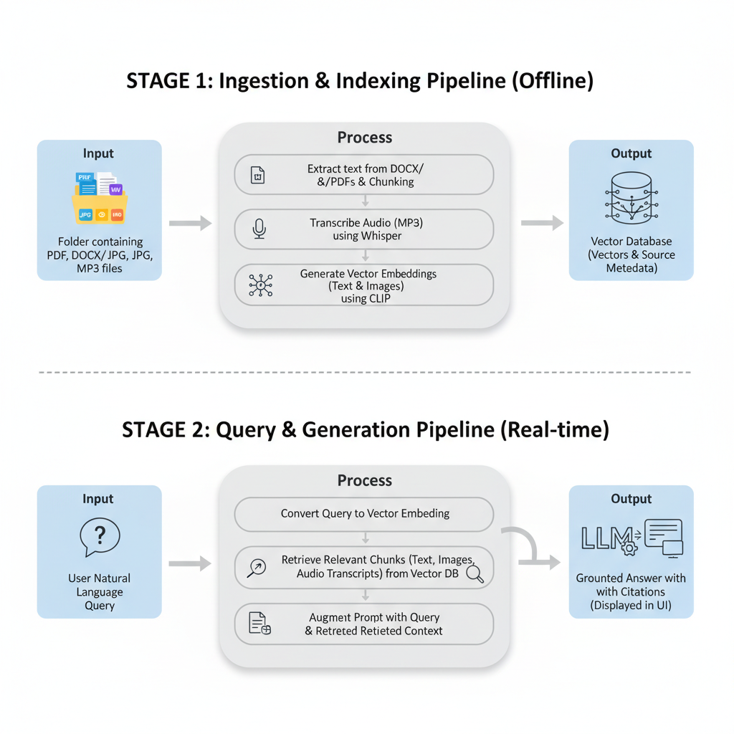
TECHNICAL APPROACH
Gnosvia
Technologies to be used:
Large Language Models (LLM): Locally hosted open-source models like Llama 3, Mistral, or Phi-3.
Speech-to-Text Model: Whisper (running on the local machine).
Embedding Models: Sentence-Transformers (for text) and CLIP (for images), both running locally.
Document Processing: PyMuPDF (for PDFs), python-docx (for DOCX).
Vector Database: ChromaDB or FAISS for efficient semantic search.
Orchestration Framework: LangChain or LlamaIndex.
Backend & Frontend: Python with FastAPI, and Streamlit

Slide 4
FEASIBILITY AND VIABILITY
Gnosvia
feasibility of the idea:
The project is highly feasible due to the availability of powerful open-source libraries (LangChain, ChromaDB) and powerful, open-source models (like Llama 3 and Mistral) that can be run entirely offline on local hardware.
An MVP can be built quickly by focusing on text and image modalities first, then integrating audio.
The modular design allows for swapping components (e.g., changing the LLM or vector database) easily.
Potential challenges and risks:
Challenge:Significant local hardware requirements (e.g., a powerful GPU with high VRAM, substantial RAM) to run the LLM and other models efficiently.
Risk: Ensuring the quality of retrieval; irrelevant information can confuse the LLM and lead to poor answers.
Challenge: Managing the complexity of linking and citing different data formats accurately.
Strategies for overcoming these challenges:
Utilize quantized versions of the models (e.g., GGUF, GPTQ) and efficient runtimes like Ollama or llama.cpp. This dramatically reduces the VRAM and RAM footprint, making the system viable on modern consumer-grade hardware.
Retrieval Quality: Implement advanced techniques like re-ranking the retrieved results to ensure the most relevant context is fed to the LLM.
Citations: Store rich metadata (e.g., page number, file name, timestamp) alongside each vector to ensure citations are precise.

Slide 5
IMPACT AND BENEFITS
Gnosvia
Potential impact on the target audience:
For intelligence analysts, researchers, and corporate teams, this tool transforms hours of manual search into seconds of automated discovery.
It democratizes data science, allowing non-technical users to perform complex, cross-functional data analysis.
Complete Security & Data Privacy: Because the entire system runs offline, no sensitive or confidential data ever leaves the user's local machine or private network. This is a critical advantage for organizations handling secure information.
Benefits of the solution:
Efficiency Boost: Provides a >90% reduction in time spent searching for information across scattered documents and media files.
Enhanced Insight: Uncovers hidden connections between different data types (e.g., a detail in a phone call and a figure in a report) that would otherwise be missed.
Trust & Transparency: Grounded answers with clear citations build user trust and allow for easy fact-checking, eliminating the "black box" problem of traditional AI.

Slide 6
RESEARCH AND REFERENCES
Gnosvia
A Taxonomy of Transcendence (Primary Paper): Abreu, N., Zhang, E., Malach, E., & Saphra, N. (2025). "A Taxonomy of Transcendence." Published as a conference paper at COLM 2025. This paper outlines the three modes of transcendence that form the theoretical basis of our project.
https://arxiv.org/abs/2508.17669
Transcendence Framework (Foundational Paper): Zhang, E., et al. (2024). "Transcendence: Generative models can outperform the experts that train them". This is the key paper that Abreu et al. (2025) builds upon, formally describing the phenomenon of transcendence.
https://arxiv.org/abs/2406.11741
LangChain Documentation: The primary software framework we will use for developing our RAG application and orchestrating the different AI models.
https://python.langchain.com/
Vector Databases Explained: An article explaining Vector Databases, the core technology for the efficient semantic search and retrieval component of our RAG system.
https://www.pinecone.io/learn/vector-database/

